Slide 1
EMTH403
Mathematical Foundation for Computer Science

Slide 2
Lecture Outcomes
understand what are Predicates.
understand what are the statement function, variables
understand binary, ternary and n – ary predicate .

Slide 3
Predicates
In this section we will introduce a more powerful type of logic called predicate logic.
We will see how predicate logic can be used to express the meaning of a wide range of statements in mathematics and computer science in ways that permit us to reason and explore relationships between objects.

Slide 4
Predicates
To understand predicate logic, we first need to introduce the concept of a predicate.
Afterward, we will introduce the notion of quantifiers, which enable us to reason with statements that assert that a certain property holds for all objects of a certain type and with statements that assert the existence of an object with a particular property.

Slide 5
Predicates
The statement “x is greater than 3” has two parts. The first part, the variable x, is the subject of the statement.
The second part—the predicate, “is greater than 3”—refers to a property that the subject of the statement can have.

Slide 6
Predicates
Statements involving variables, such as
“x > 3,” “x = y + 3,” “x + y = z,”
and
“computer x is under attack by an intruder,”
and
“computer x is functioning properly,”

Slide 7
Predicates
We can denote the statement “x is greater than 3” by P(x), where P denotes the predicate “is greater than 3” and x is the variable.
The statement P(x) is also said to be the value of the propositional function P at x.

Slide 8
Predicates
Once a value has been assigned to the variable x, the statement P(x) becomes a proposition and has a truth value.

Slide 9
Propositional function – 1 Variable Example - 1
Ques:- Let P(x) denote the statement “x > 3.” What is the truth values of P(4)?
Ans:- We obtain the statement P(4) by setting x = 4 in the statement “x > 3.”
Hence, P(4), which is the statement “4 > 3,” is true.

Slide 10
Propositional function – 1 Variable Example - 2
Ques:- Let P(x) denote the statement “x > 3.” What is the truth values of P(2)?
Ans:- P(2), which is the statement “2 > 3,” is false.

Slide 11
Propositional function – 1 Variable Example - 3
Ques:- Let A(x) denote the statement “Computer x is under attack by an intruder.” Suppose that of the computers on campus, only CS2 and MATH1 are currently under attack by intruders. What are truth values of A(CS1)?
Ans:- We obtain the statement A(CS1) by setting x = CS1 in the statement “Computer x is under attack by an intruder.” Because CS1 is not on the list of computers currently under
attack, we conclude that A(CS1) is false.

Slide 12
Propositional function – 1 Variable Example - 4
Ques:- Let A(x) denote the statement “Computer x is under attack by an intruder.” Suppose that of the computers on campus, only CS2 and MATH1 are currently under attack by intruders. What are truth values of A(CS2), and A(MATH1)?
Ans:- Because CS2 and MATH1 are on the list of
computers under attack, we know that A(CS2) and A(MATH1) are true.

Slide 13

Propositional function – 1 Variable Example - 5
Ques:-Let P(x) denote the statement “x ≤ 4.” What is the truth value of P(0) ?
Ans:-T, since 0 $≤$ 4

Slide 14

Propositional function – 1 Variable Example - 6
Ques:- Let P(x) denote the statement “x ≤ 4.” What is the truth value of P(4)?
Ans:- T, since 4 $≤$ 4.

Slide 15


Propositional function – 1 Variable Example - 7
Ques:- Let P(x) denote the statement “x ≤ 4.” What is the truth value of P(6)?
Ans:- F, since 6 $≤$ 4
$$∕$$

Slide 16
Propositional function – 1 Variable Example - 8
Ques:- Let P(x) be the statement “x = x².” If the domain consists of the integers, What is the truth value of P(0)?
Ans:- T, since 0 = 0²

Slide 17
Propositional function – 1 Variable Example - 9
Ques:- Let P(x) be the statement “x = x².” If the domain consists of the integers, What is the truth value of P(1)?
Ans:- T, since 1 = 1²

Slide 18
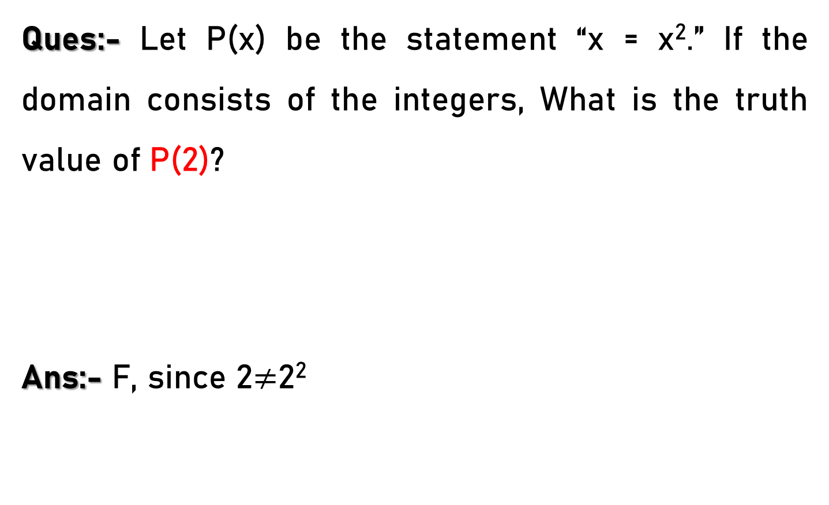
Propositional function – 1 Variable Example - 10
Ques:- Let P(x) be the statement “x = x².” If the domain consists of the integers, What is the truth value of P(2)?
Ans:- F, since 2$≠$2²

Slide 19

Propositional function – 1 Variable Example - 11
Ques:- Let P(x) be the statement “x = x².” If the domain consists of the integers, What is the truth value of P(−1)?
Ans:- F, since -1$≠$ (-1)²

Slide 20
Propositional function – 2 Variables Example - 1
Ques:- Let Q(x, y) denote the statement “x = y + 3.” What are the truth values of the propositions
Q(1, 2)?
Ans:- To obtain Q(1, 2), set x = 1 and y = 2 in the statement Q(x, y). Hence, Q(1, 2) is the statement
“1 = 2 + 3,” which is false.

Slide 21
Propositional function – 2 Variables Example - 2
Ques:- Let Q(x, y) denote the statement “x = y + 3.” What are the truth values of the propositions
Q(3, 0)?
Ans:- The statement Q(3, 0) is the proposition
“3 = 0 + 3,” which is true.

Slide 22
Propositional function – 2 Variables Example - 3
Ques:- Let A(c, n) denote the statement “Computer c is connected to network n,” where c is a variable representing a computer and n is a variable representing a network. Suppose that the computer MATH1 is connected to network CAMPUS2, but not to network CAMPUS1. What is the values of A(MATH1, CAMPUS1)?
Ans:- Because MATH1 is not connected to the CAMPUS1 network, we see that A(MATH1, CAMPUS1) is false.

Slide 23
Propositional function – 2 Variables Example - 4
Ques:- Let A(c, n) denote the statement “Computer c is connected to network n,” where c is a variable representing a computer and n is a variable representing a network. Suppose that the computer MATH1 is connected to network CAMPUS2, but not to network CAMPUS1. What is the values of A(MATH1, CAMPUS2)?
Ans:- However, because MATH1 is connected to the CAMPUS2 network, we see that A(MATH1, CAMPUS2) is true.

Slide 24
Propositional function – 2 Variables Example - 5
Ques:- Let Q(x, y) denote the statement “x is the capital of y.” What is the truth value of
Q(Delhi, India)?
Ans:- This is true

Slide 25
Propositional function – 3 Variables Example - 1
Ques:- What is the truth values of the propositions R(1, 2, 3) where R(x, y, z) denote the statement “x + y = z.”?
Ans:- The proposition R(1, 2, 3) is obtained by setting x = 1, y = 2, and z = 3 in the statement R(x, y, z). We see that R(1, 2, 3) is the statement “1 + 2 = 3,” which is true.

Slide 26
Propositional function – 3 Variables Example - 2
Ques:- What is the truth values of the propositions R(0, 0, 1) where R(x, y, z) denote the statement “x + y = z.”?
Ans:- That R(0, 0, 1), is the statement “0 + 0 = 1,” is false.

Slide 27
Propositional function – n Variables Example
A statement of the form P(x₁, x₂, . . . , x_{n}) is the value of the propositional function P at the n-tuple (x₁, x₂, . . . , x_{n}), and P is also called an n-place predicate or a n- ary predicate.

